Slide 1
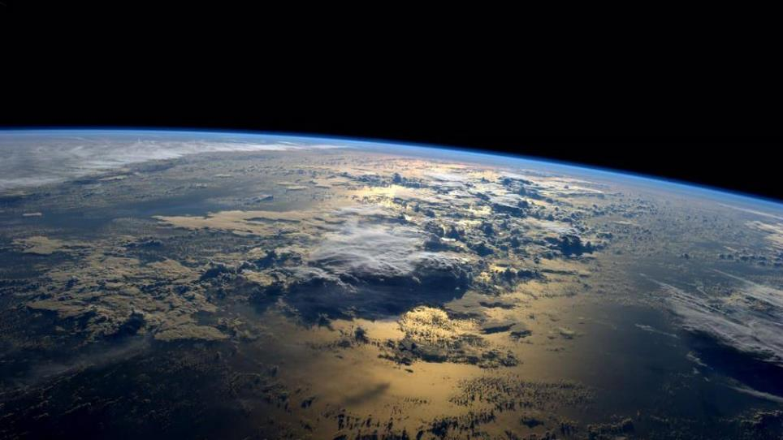
What is the answer to life, the universe and everything?
Informacijska pismenost u dječjim knjižnicama Igor Ljubuncic, March 2017
Note: Image taken from nasa.gov; in public domain; used for illustration purposes only.

Slide 2
42
And bring your towel, too
What is the answer to life, the universe and everything?
dedoimedo.com
2

Slide 3
Igor Ljubuncic
Business and Strategy Consultant
UK(but summers @ Brac!)
Books
Patents
Dedoimedo.com

Slide 4
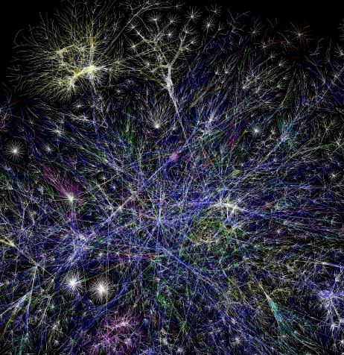
The Internet has all the answers …
Note: Image taken from Wikipedia; licensed under CC BY 2.5; used for illustration purposes only.
What is the answer to life, the universe and everything?
dedoimedo.com
4

Slide 5
Do you know how to search?
Note: Image taken from freeimages.com; courtesy of Alan Belmer; used for illustration purposes only.

Slide 6
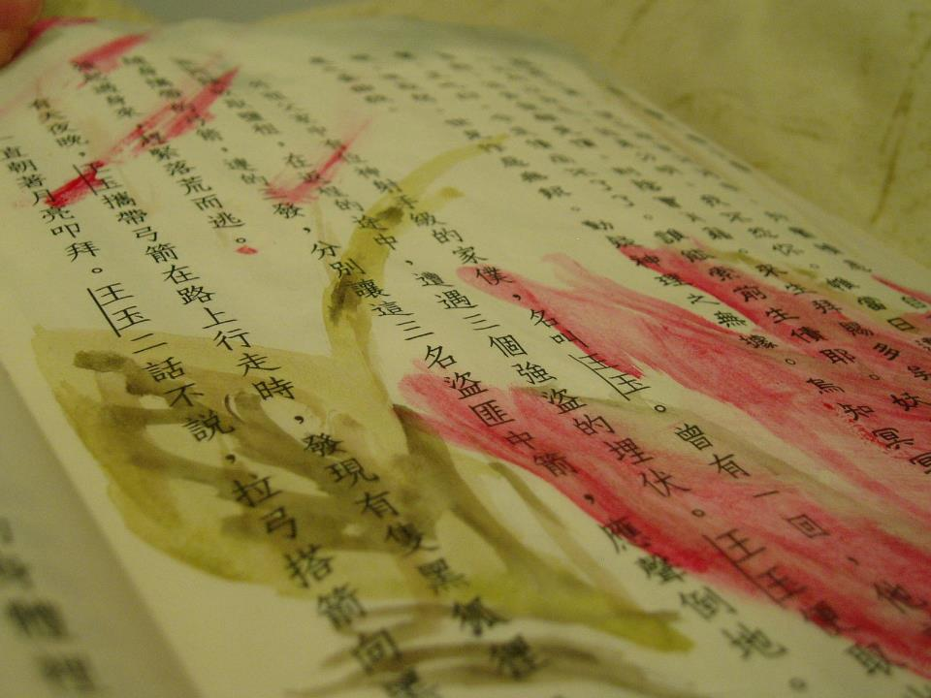
Problem #1
People = natural language
Note: Image taken from freeimages.com; courtesy of _rebirth; used for illustration purposes only.

Slide 7
Problem #1
Computers … algorithms
Note: Image taken from freeimages.com; courtesy of nokialex; used for illustration purposes only.

Slide 8
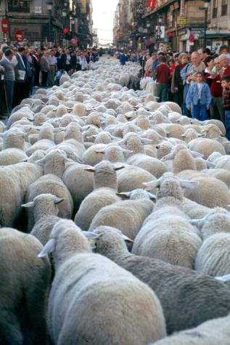
When you ask questions
Humans: “What is the best way to get to Pleso to avoid traffic jams?”
Computers: “From Zvonimirova 17 to Zagreb airport morning time fastest route.”
Note: Image taken from freeimages.com, courtesy of Jose A. Warletta; used for illustration purposes only.
What is the answer to life, the universe and everything?
dedoimedo.com
8

Slide 9
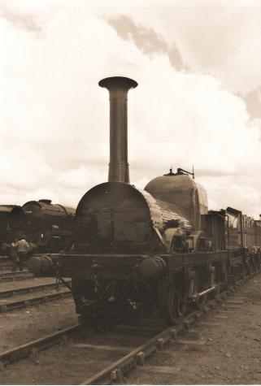
Problem #2
Note: Image taken from freeimages.com, courtesy of agustin muniz; used for illustration purposes only.
Note: Image taken from freeimages.com, courtesy of jim daly; used for illustration purposes only.
What is the answer to life, the universe and everything?
dedoimedo.com
9

Slide 10
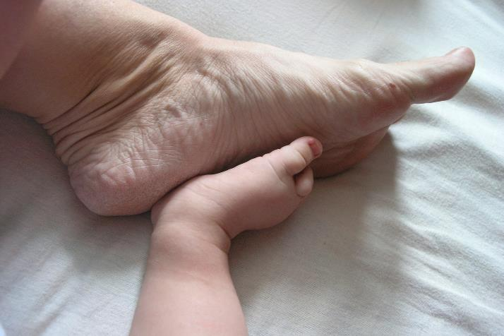
Problem #2
Note: Image taken from freeimages.com, courtesy of Gregor Varl; used for illustration purposes only.
What is the answer to life, the universe and everything?
dedoimedo.com
10

Slide 11
Information literacy
Cannot be separated from technology
Curiosity + Language + Technology
“HE WHO CONTROLS THE TECHNOLOGY, CONTROLS THE INFORMATION” –NIETZSCHE
What is the answer to life, the universe and everything?
dedoimedo.com
11

Slide 12
Basics
Search should be deterministic
Who, what, when, how (but not why!)
Search engines, 1st point of entry – learn them
Modern information is subjective
Find the source
The Internet is dangerous, too
What is the answer to life, the universe and everything?
dedoimedo.com
12

Slide 13
Summary
We (the educators) need to learn the language of tomorrow
Different mindset
Children must develop natural AND programmatic thinking
Information trustworthiness is at risk
And it’s only been 20 years …
What is the answer to life, the universe and everything?
dedoimedo.com
13

Slide 14
Thank you!
Any questions: webmaster at dedoimedo.com

