Slide 1
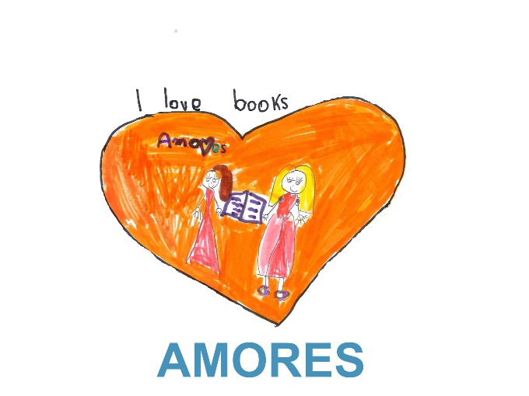
Gordana Jugo, Ivanec, 3.10.2014.
Otkrivanje ljubavi prema književnosti kroz digitalnu suradnju i kreativnost
Notes:
Title slide includes project logo, slogan and LLP logo. Presenter can add name, venue and date in the space provided.

Slide 2
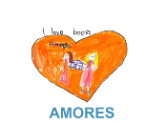
Notes:
Some statistics on children’s reading habits in the EU.
Some statistics on children’s reading habits in the EU. The PISA 2009 survey on reading skills shows that on average in European countries, one in five 15-year-olds has very low reading skills. Mrs. Vassiliou calls it a potential catastrophe for European societies because those children are at greater risk of exclusion from the labour market and also excluded from further learning. The European Council (2008) has urged Member States to reduce substantially the number of young people with insufficient reading skills and Member States were invited to focus cooperation on increasing levels of literacy. However, current trends indicate a drastic decline in book reading among children and youth. For example, 2011 National Literacy Trust’s annual survey showed that 57% of children and young people read magazines in comparison with 77% in 2005, while comic reading has dropped from 64% to 50%. The same research showed that more than a fifth of children and young people (22%) rarely or never read in their own time and that nearly a fifth (17%) would be embarrassed if their friends saw them reading. Research conducted within Learning and Teaching of Children’s Literature in Europe project showed that most children read from 15 minutes to about an hour a day. On the other hand, children spend more time using ICT. For example, a survey conducted in 2011 by the EU Kids Online network showed that 9-16 year old internet users spend 88 minutes per day online, on average.

Slide 3
Ciljevi projekta
Unaprijediti učenje književnosti diljem Europe omogućujući učenicima aktivniji angažman kroz korištenje metodologije zasnovane na kreativnosti i suradnji,
Povećati digitalne kompetencije učenika i nastavnika kroz stvaranje e-artefakata,
Osnažiti nastavnike korištenjem novih tehnologija s ciljem povećavanja njihovih pedagoških kompetencija,
Povećati održivost kroz europsku komponentu – učenici će dijeliti znanje s vršnjacima iz drugih zemalja te tako promovirati osjećaj europskog identiteta.

Slide 4
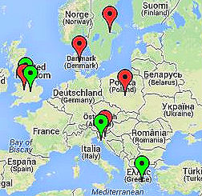
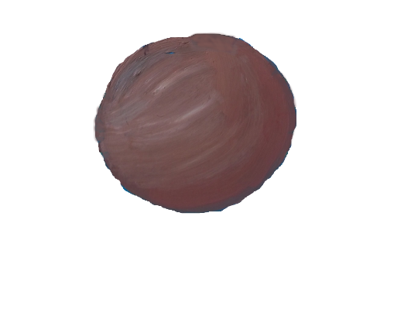
2 god.
5 škola
9 partnera
200 učenika
10 nastavnika
Notes:
This slide introduces the project and gives an overview of numbers and facts. The consortium is comprised of 9 partners from 6 countries. The project will last from 01/12/2013 to 30/11/2015. The AMORES methodology will be developed and tested in five schools in five different countries, with a total of 10 teachers and around 200 students.
The map shows the countries participating in the project. Red markers denote schools and partners linked to schools, while green denote other partners.
This is the first of a series of slides with the planet of the Little Prince and the rose. The motif was chosen because the official project poster depicts the Little Prince typing at a computer on his planet. The poster can be seen on the second last slide. In each of the following slides, the rose moves further along the planet’s surface in a clockwise direction as the various project components are introduced.

Slide 5
Natječaj za izradu loga
Notes:
One of the first steps was to develop a project identity. A logo competition was organised and schools and individual students from participating countries and beyond were invited to submit logo proposals. The contest was highly successful, with more than 100 proposals coming in. Members of the steering group selected one image for the project logo and another for the poster, for use in dissemination activities. This was done at the kick-off meeting of the steering group in Athens. The winners received a prize.

Slide 6
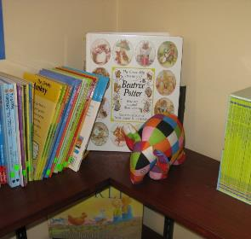
Pregled dostupne literature & analiza potreba korisnika
Notes:
Parallel to the logo contest work on work package 1 began. This work package sets the groundwork for the remainder of the project. There are two main purposes:
1) to prepare a literature review of the current status of the use of e-artefacts in learning and teaching, specifically of their use in teaching national literatures and 2)
to conduct a user needs analysis at the five target schools, to synthesise information from the schools regarding the learner context (size of school, socioeconomic status, educational attainment, special requirements of school), specific learner needs (a profile of individual learners’ abilities with digital literacy and reading literacy, engagement, motivation and self-efficacy, their knowledge of, an interest in, their national literature) and teacher needs (the teachers’ experience and understanding of the use of e-artefacts in their practice, their experience of international collaboration, their perceptions of technologies in education, their satisfaction with their role).
The picture was taken at St Mary’s Catholic Primary School in the UK.

Slide 7
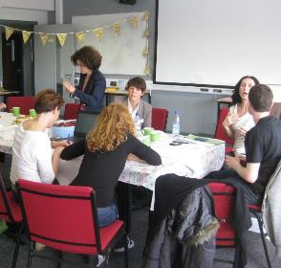
Radionica za nastavnike
Notes:
Work package 2 opened with the teachers’ workshop in Stoke-on-Trent, UK. Teachers from all participating schools, facilitated by expert partners drafted the AMORES methodology in a workshop which employed participatory methodology. This approach emerged due to dissatisfaction with top down approaches to deriving solutions that have tended to be inappropriate and unsustainable (Tavares et al, 2011). It assumes the audience are the experts who understand their reality and, through appropriate facilitation, have the capacity to design relevant solutions. Participative methods enable people to work together where all voices are heard and consensus achieved.
The picture was taken at the teachers’ workshop.

Slide 8
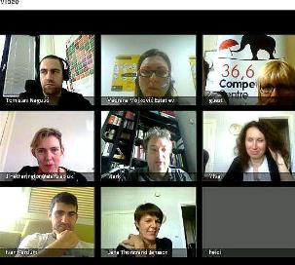
Online tečaj &
AMORES metodologija
Notes:
Following the teachers’ workshop, an online course was organised for the teachers. The objective of this course was to enable teachers to develop basic skills necessary for use of interactive ICT tools for creating e-artefacts and for creating activities envisaged in the AMORES methodology. The training also empowered teachers by developing their competence and confidence in the use of interactive ICT tools in classroom. The training was envisaged in online format so as to be cost-effective and to prepare participating teachers for future online collaboration.
This online course will be published as OER.
Towards the end of work package 2 the methodology drafted by teachers at the UK workshop was expanded with recommended ICT tools (and generic requirements for tools since they are rapidly changing) after the completed selection of technology.
The picture shows the teachers and other project partners in a videoconference during the online course.

Slide 9
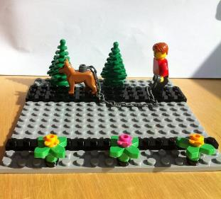
Implementacija pilota
Notes:
The next stage – implementation – begins in September (at the beginning of the school year) and will last until June. The aim of the AMORES methodology is to encourage greater student engagement with literature through the interactive and collaborative use of ICT. The students will create digital artefacts and share these with their peers in countries around Europe. For example, Croatian students might create videos around Croatian literary works and then share and discuss these online, via videoconference, with students from the United Kingdom. During the pilot phase the new methodology will be tested in actual use by teachers and students who will have chance to influence the revision of the methodology through the student voice approach. The fact that the new methodology will be tested in five different contexts makes the project results representative at a European level.
The picture shows a scene in Lego created in class by children from Denmark.

Slide 10
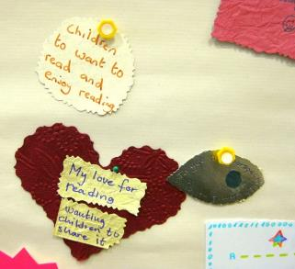
Evaluacija & prilagodba AMORES metodologije
Notes:
When the school year is over, evaluation and revision of the methodology will take place. The data and evaluation report will produce a series of discoveries about the best practice for using e-artefacts in in learning and teaching of national literatures to enhance literacies, to improve student motivation, engagement and self-efficacy and to improve knowledge of national literatures and their role in European culture. These discoveries will be used to refine the AMORES methodology used in learning and teaching, and to create an improved online course for teachers on how to use the AMORES methodology in practice. The revised methodology will therefore consist of exemplars of good practice: example materials produced as outputs from WP3 and a series of guidance materials for teachers using e-artefacts.
The picture shows a part of a group artefact created by teachers at the teachers’ workshop in the UK.

Slide 11
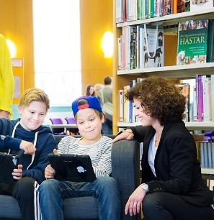
Diseminacija, osiguranje kvalitete & eksploatacija projekta
Notes:
To make sure the project is carried out successfully, other activities must be carried out as well.
The dissemination package aims to valorise project outcomes at the national and European level. Dissemination is a continuous process throughout the project, raising the awareness of the project from the upset and encouraging the uptake of the methodology among teachers, parents, psychologists, and policy makers.
The quality assurance package aims to determine whether project delivery processes are working correctly, to judge the effectiveness of the project, to check whether products developed are doing what they were designed to do and assess project impact.
The exploitation package involves all the necessary actions for allowing the project to go on after the funding period and ensure the sustainability of the project through replication and multiplication of project results.
The picture shows teachers from Sweden who are participating in the project and their students. The picture was used in the Swedish press coverage of AMORES.

Slide 12
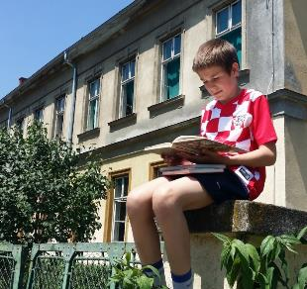
Sudjelovanjem
u projektu AMORES
djeca će razviti ljubav
prema književnosti
Notes:
The result of the project will be to help children develop a love of literature through digital collaboration and creativity.
Despite the not very encouraging statistics on children’s reading habits from the beginning of the presentation, the situation is quite different when it comes to children using ICT. For example, a survey conducted in 2011 by the EU Kids Online network showed that 9-16 year old internet users spend 88 minutes per day online, on average.
Students are motivated and engaged when methodologies used in the classroom are based on the co-creation of content and sharing this work through wider dissemination across the internet.
All teachers agree that the use of ICT could help raise the level of students’ interest in their national literature.
The picture shows a child in Croatia reading in the school playground.

Slide 13
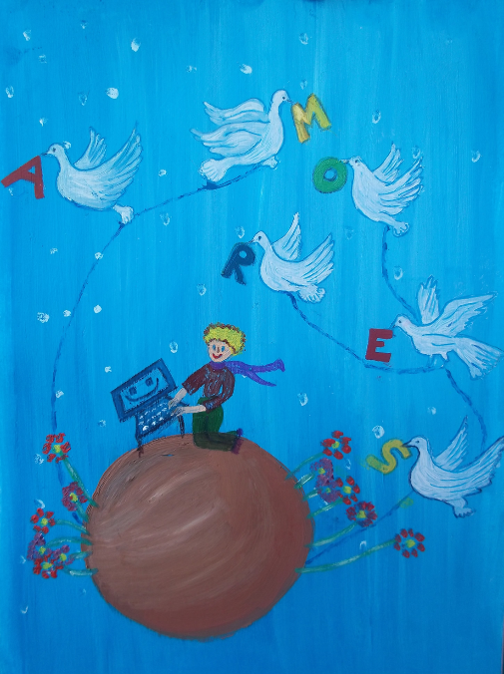
Notes:
This is the poster selected as the official project poster at the steering group meeting in Greece.
It is particularly symbolic of the project message (logo) – Developing a love of literature through digital collaboration and creativity – because the Little Prince, a favorite literary character, is working on a computer.

Slide 14
Podržite nas na
amores-project.eu &
facebook/amoresproject
amores@carnet.hr
Notes:
The audience is invited to support AMORES by visiting the project website and Facebook page.

